Slide 1

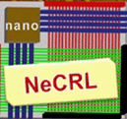
Design of Non-Volatile Latch using Resistive Memory Technology
Aliyar Attaran, Tyler Sheaves and Hamid Mahmoodi
School of Engineering
San Francisco State University, San Francisco, CA
June 2017

Slide 2
Resistive Memory Technology
In traditional computer memory technologies, information is stored as charge
In resistive memory technologies, information is stored as resistance state
Advantage of resistive memory technology: scalability, non-volatility, low power

Slide 3
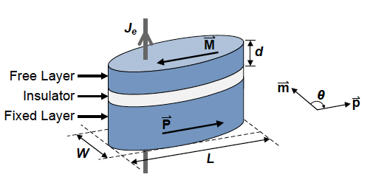
Examples of Resistive Memory Technology
Spin-Transfer Torque RAM (STTRAM)
Resistive RAM (ReRAM)

Slide 4
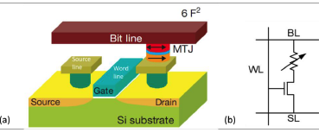
Spin Transfer Torque Memory Technology
Spin Transfer Torque Random Access Memory (STTRAM) is a promising technology for information storage in form of magnetic orientation.
Advantages: non-volatility, ease of programming, scalability and standard CMOS compatibility, near zero leakage.
STTRAM cell consists of two components:
Magnetic Tunnel Junction (MTJ)
Access transistor
Iong Ying Loh, Master Thesis, MIT, 2009
Notes:
Therefore STTRAM has emerged as an alternative to conventional CMOS SRAM that offers significant leakage power reduction since the information is stored in the form of a programmable resistance represented by a Magnetic Tunneling Junction (MTJ) rather than by electron charge.
The main target application of STTRAM is for storage and the main targeted market is replacement of DRAM main memory and SRAM cache.

Slide 5
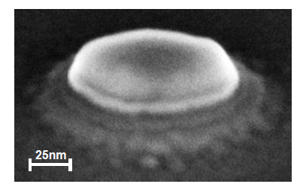
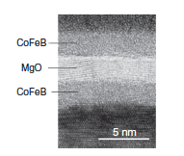
Magnetic Tunnel Junction (MTJ)
Two Ferromagnetic Layers
Fixed layer
Free layer
One oxide Barrier Layer
MgO or AL₂O₃
The resistance of MTJ depends on the relative magnetization direction of the two ferromagnetic layers.
Richard William Dorrance, Master Thesis, UCLA, 2011
T. Kawahara,Microelectronics Reliability Jr.
Notes:
The resistance of MTJ depends on the relative magnetization direction (MDs) of the two FLs.

Slide 6
Magnetic Tunnel Junction (MTJ)
Two states of parallel and anti-parallel are programmed by write current direction
The current, if large enough, results in STT switching and change of state
Parallel state: Low
Resistance (RL)
Anti-Parallel State: High
Resistance (RH)

Slide 7
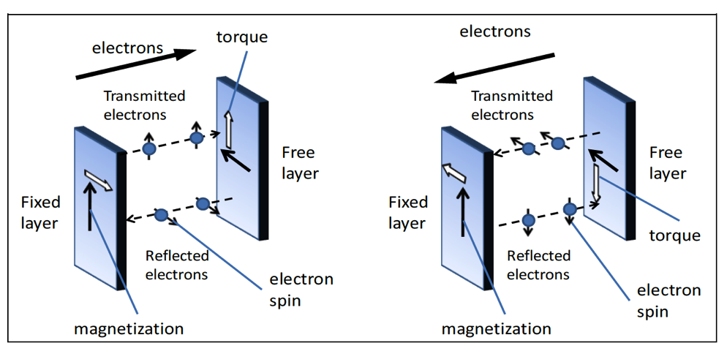
Spin Transfer Torque Switching
Physics behind write operation (change of state)
Switching to Parallel State
Switching to Anti-Parallel State
Iong Ying Loh, Master Thesis, MIT, 2009

Slide 8
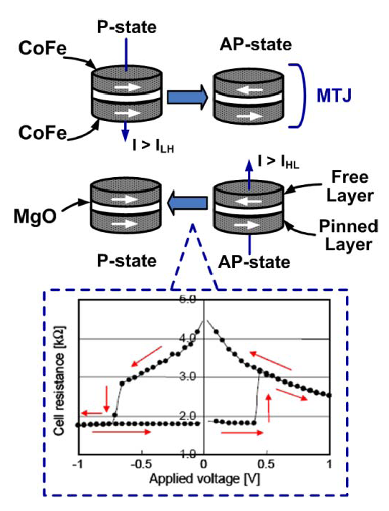
MTJ Resistance-Voltage Characteristics
High voltage for write
Low voltage for read
Information stored and sensed as resistance
Paul et al, IEEE T. Nanotechnology, 2011

Slide 9
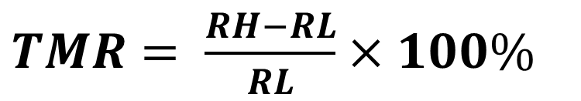
Tunneling Magneto Resistance (TMR)
TMR quantifies resistance difference between two states
Higher TMR generates larger signal difference between two states in the read mode, and hence more reliable and faster read operation

Slide 10
Read Operation of STTRAM
The word line is selected and a voltage is applied to the bit line.
Current density should be less than the switching current density.
I_{read} < Critical Write Current
WL
BL & SL Biasing
BL
Sense-Amplifier
Dout
I_{read}
SL
Clock

Slide 11
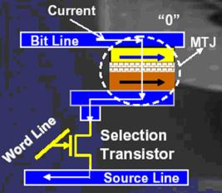
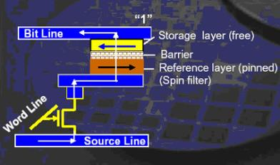
Write Operation of STTRAM
Induced current density should be larger than the critical write current density
AP =>P
I_{AP->P}
P => AP
I_{P->AP}
I_{P->AP} > I_{AP->P} > Critical Write Current

Slide 12
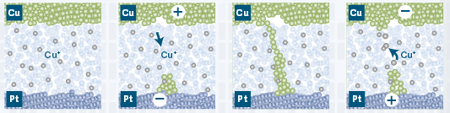
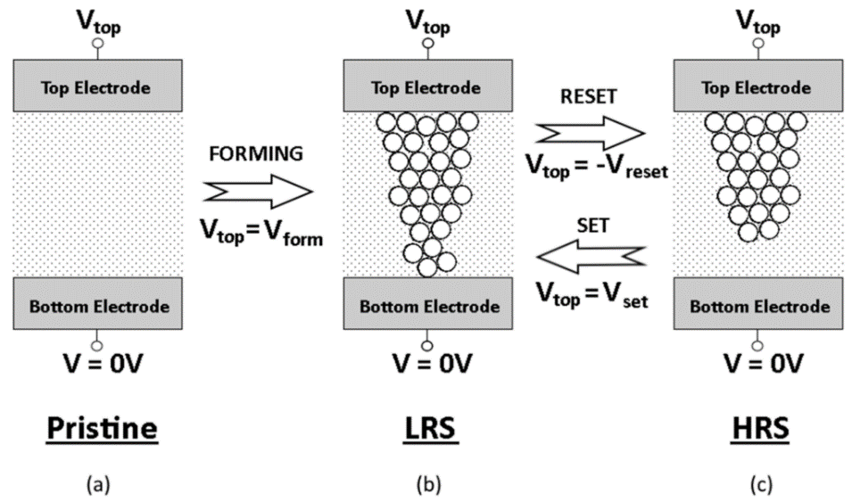
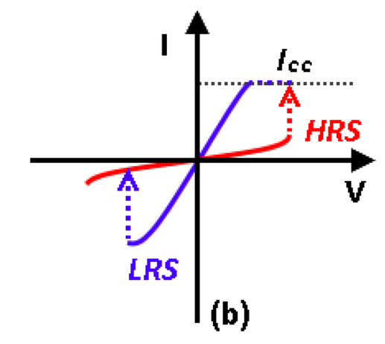
How Resistive Memory Cell Works
Schematic of the switching mechanism of metal oxide resistive switching memory (a) Switching layer in pristine state before electroformed; (b) A low resistance filament is formed when forming voltage is applied to top electrode; (c) The filament is ruptured when a negative voltage is applied and device turns into high resistant state (HRS).
Ee Wah Lim and Razali Ismail, “Conduction Mechanism of Valence Change Resistive Switching Memory: A Survey,” Electronics 2015, 4(3), 586-613

Slide 13
Non Volatile (NV) Latch
Non-volatile cell stores data in resistive form
Write driver changes the state of the NV cell
Sense Amplifier sets the sate of the volatile cell based on the state of non-volatile cell
Non-Volatile Cell
Volatile Cell
Write Driver
Sense-Amplifier
Q
Din
Write Enable
Sense Enable

Slide 14
Precharge Sensing NV-Latch
Differential resistive cells for high sensing reliability
Shared write control and bit-lines
Right after power-up, the sense enable signal (GSE) needs to switch from high to low, while write enable (WEN) is low

Slide 15
Proposed NV-Latch with Self-Resetting Feedback (SRF)
Feedback enhances robustness through self-resetting cross-coupled PMOS load

Slide 16
Research Tasks
Group Task: Perform transistor sizing optimization on precharge Sensing NV-Latch
Individual Task: Perform layout of the SRF NV-Latch in 32nm process
Metrics of optimization:
Area
Power
Delay
Reliability

